Slide 1
Currency Converter
MICRO IT PROJECT
CH ADI CHARAN
CH ADI CHARAN

Slide 2


Currency Converters: A Global Necessity
In today's interconnected world, currency converters are no longer a luxury but a fundamental tool. With an astounding $6.6 trillion traded daily in foreign exchange markets, the global economy is in constant motion. Currency fluctuations, whether minor or significant, directly impact businesses, international travelers, and online shoppers alike.
These indispensable tools provide real-time exchange rates, empowering individuals and entities to make informed financial decisions and navigate the complexities of international transactions with confidence and precision.
by Adi Charan

Slide 3
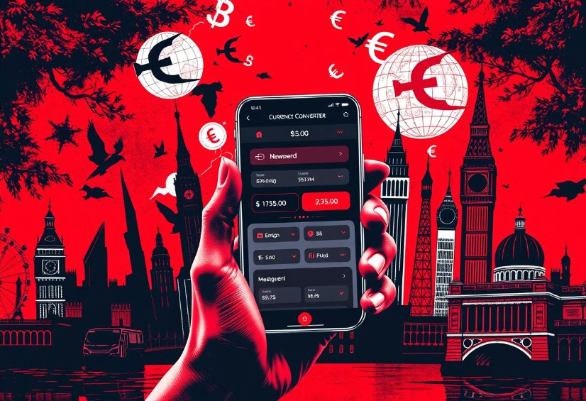
Why Use a Currency Converter?
Using a currency converter is paramount for both financial prudence and clarity in a globalized world. When traveling internationally, hidden fees on currency exchanges can erode your budget, often averaging 3-5% per transaction. A reliable converter helps you anticipate and avoid these often-overlooked costs, ensuring your money goes further.
For online shopping across borders, converters enable accurate price comparisons, revealing the true cost of goods from different countries. Furthermore, businesses rely on these tools to gain a clear understanding of international transactions, mitigating risks associated with currency volatility and ensuring accurate financial reporting.

Slide 4




How Currency Converters Work
Aggregate Data
Converters pull real-time financial data from a multitude of sources, including major banks, interbank exchanges, and financial institutions worldwide. This aggregation ensures a comprehensive and current view of the market.
Real-time APIs
They leverage sophisticated Application Programming Interfaces (APIs) to receive up-to-the-minute exchange rates. These APIs provide a continuous stream of data, reflecting the dynamic nature of global currency markets.
Calculate Conversions
Advanced algorithms are then employed to calculate precise currency conversions based on the aggregated, real-time rates. This ensures accuracy, accounting for minute fluctuations and providing users with reliable results for their transactions.

Slide 5
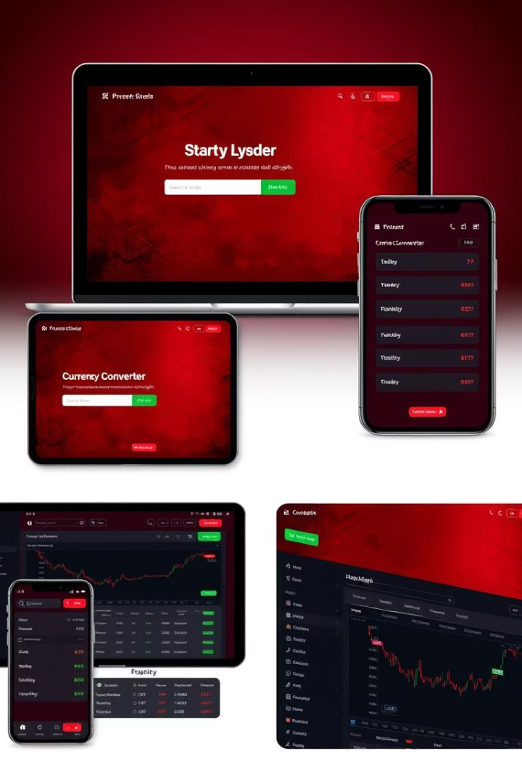



Types of Currency Converters
Online Tools
Bank & Credit Union Converters
Forex Brokers
Websites and mobile applications offer unparalleled accessibility and convenience, often featuring user-friendly interfaces and broad currency support. They are ideal for quick conversions and on-the-go access.
Specialized platforms designed for active currency trading. They offer advanced charting, analysis tools, and highly competitive interbank rates, catering to professional traders and serious investors.
These provide reliable rates, often directly linked to current bank offerings. While trustworthy, they may sometimes include transaction fees or slightly less favorable exchange rates compared to specialized services.

Slide 6
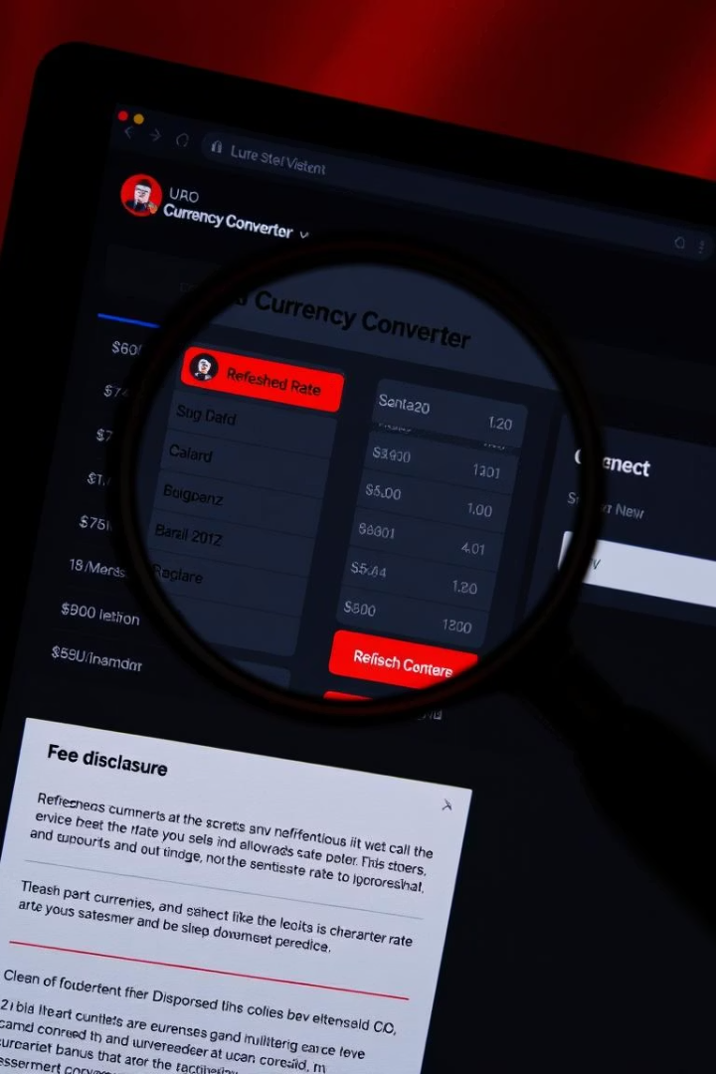




Key Features to Look For
When choosing a currency converter, several features stand out as critical for a robust and reliable tool.
Wide Currency Support
An ideal converter should support over 180 currencies, ensuring you can convert virtually any global currency pair.
Real-time Updates
Look for tools that update exchange rates every minute or even more frequently, reflecting the volatile nature of the forex market.
Historical Data
Access to past exchange rates allows for trend analysis, helping users predict future movements and make more strategic decisions.
Fee Transparency
A good converter clearly discloses any associated fees, such as spreads or commissions, ensuring you understand the true cost of your conversion.

Slide 7
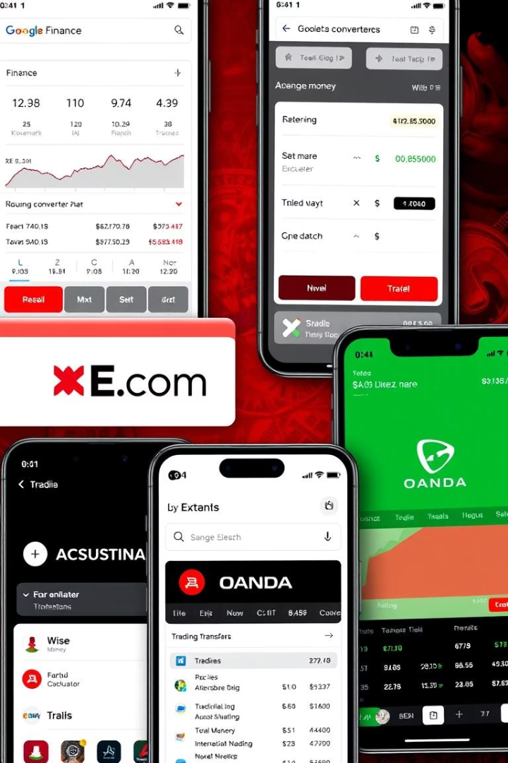
Popular Currency Converter Platforms
Google Finance
A widely used and simple tool, offering free, straightforward conversions directly integrated into Google search. It's excellent for quick checks and general information.
XE.com
Known for its comprehensive data and reliability, XE.com provides extensive currency information, including historical rates and currency news, with a paid version for advanced features.
Wise (formerly TransferWise)
Distinguished by its transparent fee structure and competitive mid-market rates, Wise is ideal for international money transfers, ensuring users get favorable exchange rates without hidden costs.
OANDA
Primarily a forex broker, OANDA also offers robust currency converter tools that leverage institutional-grade data, catering to both casual users and serious traders seeking precise rates.

Slide 8

Currency Converter APIs
Currency converter APIs are powerful programmatic interfaces that allow developers to integrate real-time exchange rates directly into their own applications, websites, or services. This eliminates the need for manual data entry and ensures that any platform can display accurate and up-to-date currency conversions automatically.
Examples of leading API providers include Fixer.io, Open Exchange Rates, and CurrencyLayer, each offering different levels of service and pricing models. Pricing typically varies based on usage volume, data frequency, and advanced features like historical data access or specific currency pairs, making them scalable for various business needs.

Slide 9
Common Mistakes to Avoid
Outdated Information
1
Exchange rates are highly volatile. Relying on rates that are even a few hours old can lead to significant discrepancies and financial losses, especially for large transactions.
Ignoring Fees
2
Many services charge hidden fees or commissions. Always factor in these costs, as they can significantly impact the final amount received or paid in your conversion.
Unreliable Sources
3
Not all currency converters are created equal. Verify the credibility and accuracy of the source; reputable platforms aggregate data from trusted financial institutions.
Failing to Compare
4
Even among reliable converters, rates can vary. Always compare rates across multiple platforms to ensure you are getting the most favorable exchange rate for your transaction.

Slide 10

Conclusion: Empowering Financial Decisions
1
2
3
Essential Tools
Informed Decisions
Tailored Choices
Currency converters are indispensable for navigating global finances.
They save time and money through accurate, real-time data.
Select a converter that aligns with your specific needs.
In summation, currency converters stand as essential tools in our increasingly globalized economy. By providing immediate access to accurate exchange rates, they empower individuals and businesses to make informed financial decisions, ultimately saving both time and money. The key lies in choosing a converter that best meets your specific requirements, whether for casual travel, online shopping, or complex international business transactions. Embrace these digital aids to navigate the complexities of global currencies with confidence and precision.

